Slide 1
Overview: modeling with UML
What is modeling?
What is UML?
Use case diagrams
Class diagrams
Next lecture
Sequence diagrams
Activity diagrams

Slide 2
What is modeling?
Modeling consists of building an abstraction of reality.
Abstractions are simplifications because:
  They ignore irrelevant details and
  They only represent the relevant details.
What is relevant or irrelevant depends on the purpose of the model.

Slide 3
Why model software?
Why model software?
Software is getting increasingly more complex
  Windows XP > 40 mio lines of code
  A single programmer cannot manage this amount of code in its entirety.
Code is not easily understandable by developers who did not write it
We need simpler representations for complex systems
  Modeling is a mean for dealing with complexity

Slide 4
Systems, Models and Views
A model is an abstraction describing a subset of a system
A view depicts selected aspects of a model
A notation is a set of graphical or textual rules for depicting views
Views and models of a single system may overlap each other
Examples:
System: Aircraft
Models: Flight simulator, scale model
Views: All blueprints, electrical wiring, fuel system

Slide 5
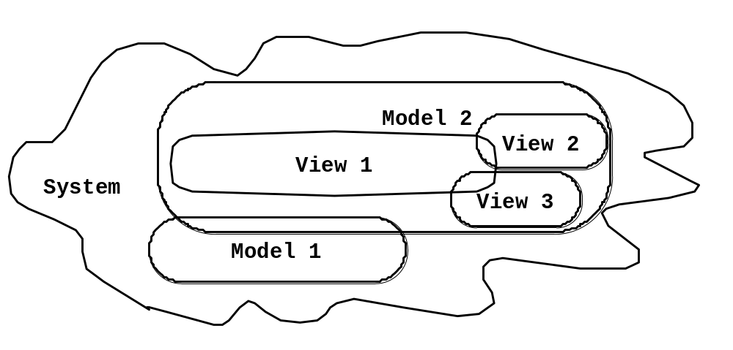
Systems, Models and Views
Flightsimulator
Blueprints
Aircraft
Electrical
Wiring
Scale Model

Slide 6
Models, Views and Systems (UML)
*
*
System
Model
View
Described by
Depicted by
Airplane: System
Scale Model: Model
Flight Simulator: Model
Blueprints: View
Fuel System: View
Electrical Wiring: View

Slide 7
Concepts and Phenomena
Phenomenon
  An object in the world of a domain as you perceive it
  Example: The lecture you are attending
  Example: My black watch
Concept
  Describes the properties of phenomena that are common.
  Example: Lectures on software engineering
  Example: Black watches
Concept is a 3-tuple:
  Name (To distinguish it from other concepts)
  Purpose (Properties that determine if a phenomenon is a member of a concept)
  Members (The set of phenomena which are part of the concept)

Slide 8
Concepts and phenomena
Name
Purpose
Members
Clock
A device that
measures time.
Abstraction
  Classification of phenomena into concepts
Modeling
  Development of abstractions to answer specific questions about a set of phenomena while ignoring irrelevant details.

Slide 9
Concepts in software: Type and Instance
Type:
  An abstraction in the context of programming languages
  Name: int, Purpose: integral number, Members: 0, -1, 1, 2, -2, . . .
Instance:
  Member of a specific type
The type of a variable represents all possible instances the variable can take
The following relationships are similar:
  “type” <–> “instance”
  “concept” <–> “phenomenon”

Slide 10
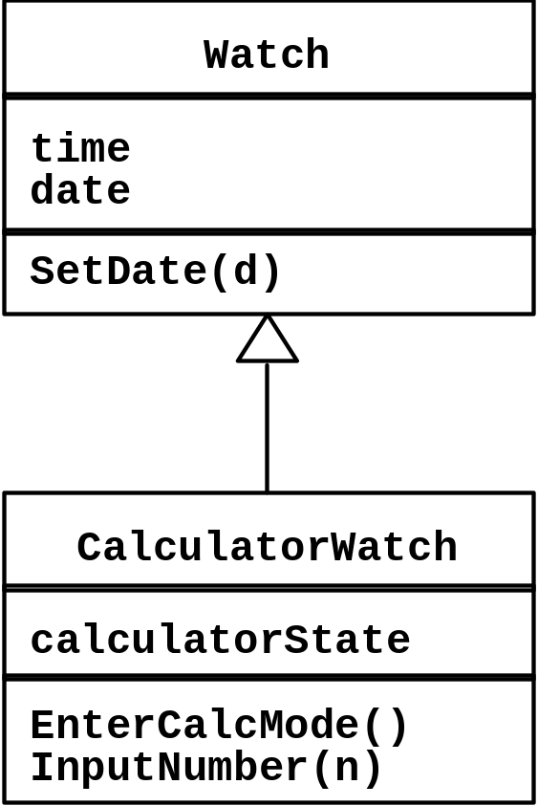
Abstract Data Types & Classes
Abstract data type
  Special type whose implementation is hidden from the rest of the system.
Class:
  An abstraction in the context of object-oriented languages
Like an abstract data type, a class encapsulates both state (variables) and behavior (methods)
  Class Vector
Unlike abstract data types, classes can be defined in terms of other classes using inheritance

Slide 11
Application and Solution Domain
Application Domain (Requirements Analysis):
  The environment in which the system is operating
Solution Domain (System Design, Object Design):
  The available technologies to build the system

Slide 12
Object-oriented modeling
Application Domain
Solution Domain
Application Domain Model
UML Package
System Model
TrafficControl
SummaryDisplay
MapDisplay
TrafficController
FlightPlanDatabase
Aircraft
FlightPlan
Airport
TrafficControl

Slide 13
What is UML?
UML (Unified Modeling Language)
  An emerging standard for modeling object-oriented software.
  Resulted from the convergence of notations from three leading object-oriented methods:
    OMT (James Rumbaugh)
    OOSE (Ivar Jacobson)
    Booch (Grady Booch)
Reference: “The Unified Modeling Language User Guide”, Addison Wesley, 1999.
Supported by several CASE tools
  Rational ROSE
  TogetherJ

Slide 14
UML: First Pass
You can model 80% of most problems by using about 20 % UML
We teach you those 20%

Slide 15
UML First Pass
Use case Diagrams
  Describe the functional behavior of the system as seen by the user.
Class diagrams
  Describe the static structure of the system: Objects, Attributes, Associations
Sequence diagrams
  Describe the dynamic behavior between actors and the system and between objects of the system
Statechart diagrams
  Describe the dynamic behavior of an individual object (essentially a finite state automaton)
Activity Diagrams
  Model the dynamic behavior of a system, in particular the workflow (essentially a flowchart)

Slide 16
UML first pass: Use case diagrams
Package
Use case
Watch
Actor
ReadTime
WatchUser
SetTime
WatchRepairPerson
ChangeBattery
Use case diagrams represent the functionality of the system
from user’s point of view

Slide 17
UML first pass: Class diagrams
Class diagrams represent the structure of the system
Association
Class
Multiplicity
Watch
1
1
1
1
2
1
2
1
PushButton
LCDDisplay
Battery
load
Time
now
state
blinkIdx
blinkSeconds()
blinkMinutes()
blinkHours()
stopBlinking()
referesh()
push()
release()
Attribute
Operations

Slide 18
UML first pass: Sequence diagram
Actor
Object
:WatchUser
:Watch
:LCDDisplay
:Time
pressButton1()
blinkHours()
pressButton1()
blinkMinutes()
Message
pressButton2()
incrementMinutes()
refresh()
pressButtons1And2()
commitNewTime()
stopBlinking()
Activation
Lifeline
Sequence diagrams represent the behavior as interactions

Slide 19
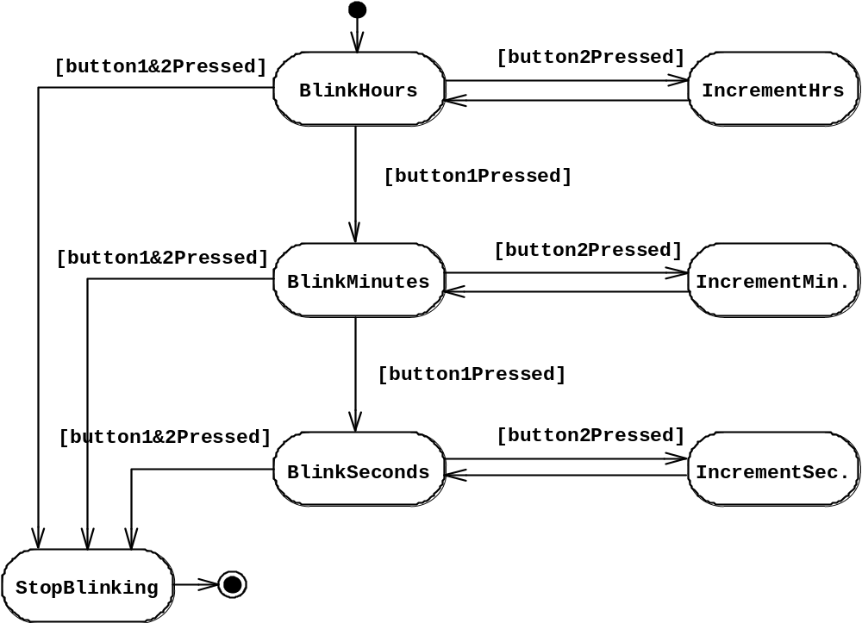
UML first pass: Statechart diagrams for objects with interesting dynamic behavior
State
Event
Initial state
Transition
Final state
Represent behavior as states and transitions

Slide 20
Other UML Notations
UML provide other notations that we will be introduced in subsequent lectures, as needed.
Implementation diagrams
  Component diagrams
  Deployment diagrams
  Introduced in lecture on System Design
Object constraint language
  Introduced in lecture on Object Design

Slide 21
UML Core Conventions
Rectangles are classes or instances
Ovals are functions or use cases
Instances are denoted with an underlined names
  myWatch:SimpleWatch
  Joe:Firefighter
Types are denoted with non underlined names
  SimpleWatch
  Firefighter
Diagrams are graphs
  Nodes are entities
  Arcs are relationships between entities

Slide 22
Use Case Diagrams
Used during requirements elicitation to represent external behavior
Actors represent roles, that is, a type of user of the system
Use cases represent a sequence of interaction for a type of functionality
The use case model is the set of all use cases. It is a complete description of the functionality of the system and its environment
Passenger
PurchaseTicket

Slide 23
Actors
An actor models an external entity which communicates with the system:
  User
  External system
  Physical environment
An actor has a unique name and an optional description.
Examples:
  Passenger: A person in the train
  GPS satellite: Provides the system with GPS coordinates
Passenger

Slide 24
Use Case
A use case represents a class of functionality provided by the system as an event flow.
A use case consists of:
Unique name
Participating actors
Entry conditions
Flow of events
Exit conditions
Special requirements
PurchaseTicket

Slide 25
Use Case Diagram: Example
Name: Purchase ticket
Participating actor: Passenger
Entry condition:
Passenger standing in front of ticket distributor.
Passenger has sufficient money to purchase ticket.
Exit condition:
Passenger has ticket.
Event flow:
1. Passenger selects the number of zones to be traveled.
2. _x0008_Distributor displays the amount due.
3. Passenger inserts money, of at least the amount due.
4. Distributor returns change.
5. Distributor issues ticket.
Anything missing?
Exceptional cases!

Slide 26
The <<extends>> Relationship
<<extends>> relationships represent exceptional or seldom invoked cases.
The exceptional event flows are factored out of the main event flow for clarity.
Use cases representing exceptional flows can extend more than one use case.
The direction of a <<extends>> relationship is to the extended use case
Passenger
PurchaseTicket
<<extends>>
<<extends>>
<<extends>>
OutOfOrder
<<extends>>
TimeOut
Cancel
NoChange

Slide 27
The <<includes>> Relationship
<<includes>> relationship represents behavior that is factored out of the use case.
<<includes>> behavior is factored out for reuse, not because it is an exception.
The direction of a <<includes>> relationship is to the using use case (unlike <<extends>> relationships).
Passenger
PurchaseMultiCard
PurchaseSingleTicket
<<includes>>
<<includes>>
<<extends>>
CollectMoney
<<extends>>
NoChange
Cancel

Slide 28
Use Case Diagrams: Summary
Use case diagrams represent external behavior
Use case diagrams are useful as an index into the use cases
Use case descriptions provide meat of model, not the use case diagrams.
All use cases need to be described for the model to be useful.

Slide 29
Class Diagrams
TarifSchedule
Enumeration getZones()
Price getPrice(Zone)
Trip
*
*
zone:Zone
Price: Price
Class diagrams represent the structure of the system.
Used
  during requirements analysis to model problem domain concepts
  during system design to model subsystems and interfaces
  during object design to model classes.

Slide 30
Classes
TarifSchedule
Table zone2price
Enumeration getZones()
Price getPrice(Zone)
Name
TarifSchedule
Attributes
Signature
zone2price
getZones()
getPrice()
Operations
TarifSchedule
A class represent a concept
A class encapsulates state (attributes) and behavior (operations).
Each attribute has a type.
Each operation has a signature.
The class name is the only mandatory information.

Slide 31
Instances
tarif_1974:TarifSchedule
zone2price = {
{‘1’, .20},
{‘2’, .40},
{‘3’, .60}}
An instance represents a phenomenon.
The name of an instance is underlined and can contain the class of the instance.
The attributes are represented with their values.

Slide 32
Actor vs Instances
What is the difference between an actor , a class and an instance?
Actor:
  An entity outside the system to be modeled, interacting with the system (“Passenger”)
Class:
  An abstraction modeling an entity in the problem domain, must be modeled inside the system (“User”)
Object:
  A specific instance of a class (“Joe, the passenger who is purchasing a ticket from the ticket distributor”).

Slide 33
Associations
TarifSchedule
TripLeg
Enumeration getZones()
Price getPrice(Zone)
*
Price
Zone
*
Associations denote relationships between classes.
The multiplicity of an association end denotes how many objects the source object can legitimately reference.

Slide 34
1-to-1 and 1-to-many Associations
Country
Has-capital
City
*
name:String
name:String
One-to-one association
Point
Polygon
*
x: Integer
draw()
y: Integer
One-to-many association

Slide 35
Many-to-Many Associations
Lists
*
*
Company
StockExchange
tickerSymbol
*
Lists
1
Company
StockExchange
tickerSymbol
SX_ID
Notes:
A stock exchange lists many companies each of them uniquely identifed by a ticker symbol used at that stock exchange.
A company can be listed on more than one stock exchange, using the same ticker symbol.
Mercedes Benz is an example for a company listed on more than one stock exchange: Frankfurt and NYSE.
Does it have two different Ticker symbols?
Something not clear here: What happens if the company cannot have the same ticker symbol on two different stock exchanges?

Slide 36
From Problem Statement To Object Model
Pr
oblem Statement: A stock exchange lists many companies. Each
company is uniquely identified by a ticker symbol
Class Diagram:
StockExchange
*
*
Company
Lists
tickerSymbol

Slide 37
From Problem Statement to Code
Pr
oblem Statement
:
A
stock exchange lists many companies.
Each company is identified by a ticker Symbol
Class Diagram:
*
*
Company
StockExchange
Lists
tickerSymbol
Java Code
public class StockExchange
{
private Vector m_Company = new Vector();
};
public class Company
{
public int m_tickerSymbol;
private Vector m_StockExchange = new Vector();
};

Slide 38
Aggregation
An aggregation is a special case of association denoting a “consists of” hierarchy.
The aggregate is the parent class, the components are the children class.
A solid diamond denotes composition, a strong form of aggregation where components cannot exist without the aggregate. (Bill of Material)
Exhaust system
Exhaust system
1
0..2
1
0..2
Muffler
Tailpipe
Muffler
Tailpipe
diameter
diameter
diameter
diameter
TicketMachine
3
ZoneButton

Slide 39
Qualifiers
Without qualification
1
*
File
Directory
filename
With qualification
1
0…1
Directory
filename
File
Qualifiers can be used to reduce the multiplicity of an association.

Slide 40
Inheritance
Button
CancelButton
ZoneButton
The children classes inherit the attributes and operations of the parent class.
Inheritance simplifies the model by eliminating redundancy.

Slide 41
Object Modeling in Practice: Class Identification
Foo
Betrag
CustomerId
Deposit()
Withdraw()
GetBalance()
Class Identification: Name of Class, Attributes and Methods

Slide 42
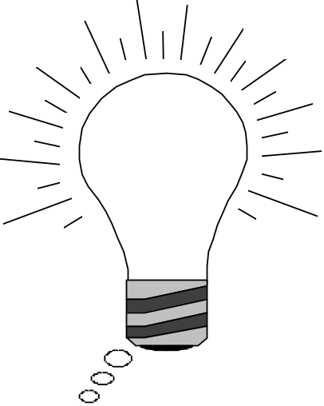

Object Modeling in Practice:
Encourage Brainstorming
“Dada”
Foo
Betrag
Betrag
CustomerId
CustomerId
Deposit()
Deposit()
Withdraw()
Withdraw()
GetBalance()
GetBalance()
Account
Betrag
CustomerId
Deposit()
Naming is important!
Is Foo the right name?
Withdraw()
GetBalance()

Slide 43
Object Modeling in Practice ctd
Account
Betrag
Customer
AccountId
Bank
CustomerId
Name
Name
Deposit()
CustomerId
Withdraw()
GetBalance()
1) Find New Objects
2) Iterate on Names, Attributes and Methods

Slide 44
Object Modeling in Practice: A Banking System
Account
Betrag
*
Customer
AccountId
Has
Bank
CustomerId
AccountId
Name
Name
Deposit()
CustomerId
Withdraw()
GetBalance()
1) Find New Objects
2) Iterate on Names, Attributes and Methods
3) Find Associations between Objects
4) Label the assocations
5) Determine the multiplicity of the assocations

Slide 45
Practice Object Modeling: Iterate, Categorize!
Account
Bank
Customer
*
Amount
*
Name
Has
Name
AccountId
CustomerId
AccountId
Deposit()
Withdraw()
GetBalance()
CustomerId()
Savings
Account
Checking
Account
Mortgage
Account
Withdraw()
Withdraw()
Withdraw()

Slide 46
Packages
A package is a UML mechanism for organizing elements into groups (usually not an application domain concept)
Packages are the basic grouping construct with which you may organize UML models to increase their readability.
A complex system can be decomposed into subsystems, where each subsystem is modeled as a package
DispatcherInterface
Notification
IncidentManagement

Slide 47
UML sequence diagrams
Used during requirements analysis
  To refine use case descriptions
  to find additional objects (“participating objects”)
Used during system design
  to refine subsystem interfaces
Classes are represented by columns
Messages are represented by arrows
Activations are represented by narrow rectangles
Lifelines are represented by dashed lines
Passenger
TicketMachine
selectZone()
insertCoins()
pickupChange()
pickUpTicket()

Slide 48
Nested messages
Passenger
ZoneButton
TarifSchedule
Display
selectZone()
lookupPrice(selection)
price
Dataflow
displayPrice(price)
…to be continued...
The source of an arrow indicates the activation which sent the message
An activation is as long as all nested activations
Horizontal dashed arrows indicate data flow
Vertical dashed lines indicate lifelines

Slide 49
Iteration & condition
…continued from previous slide...
Passenger
ChangeProcessor
CoinIdentifier
Display
CoinDrop
*
insertChange(coin)
lookupCoin(coin)
Iteration
price
displayPrice(owedAmount)
Condition
[owedAmount<0] returnChange(-owedAmount)
…to be continued...
Iteration is denoted by a * preceding the message name
Condition is denoted by boolean expression in [ ] before the message name

Slide 50
Creation and destruction
…continued from previous slide...
Passenger
ChangeProcessor
Creation
createTicket(selection)
Ticket
print()
free()
Destruction
Creation is denoted by a message arrow pointing to the object.
Destruction is denoted by an X mark at the end of the destruction activation.
In garbage collection environments, destruction can be used to denote the end of the useful life of an object.

Slide 51
Sequence Diagram Summary
UML sequence diagram represent behavior in terms of interactions.
Useful to find missing objects.
Time consuming to build but worth the investment.
Complement the class diagrams (which represent structure).

Slide 52
State Chart Diagrams
Initial state
State
Event
Transition
Final state
Represent behavior as states and transitions

Slide 53
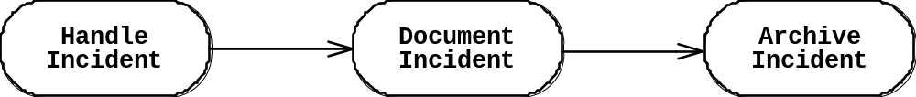
Activity Diagrams
An activity diagram shows flow control within a system
An activity diagram is a special case of a state chart diagram in which states are activities (“functions”)
Two types of states:
  Action state:
    Cannot be decomposed any further
    Happens “instantaneously” with respect to the level of abstraction used in the model
  Activity state:
    Can be decomposed further
    The activity is modeled by another activity diagram

Slide 54
Statechart Diagram vs. Activity Diagram
Statechart Diagram for Incident (similar to Mealy Automaton)
(State: Attribute or Collection of Attributes of object of type Incident)
Event causes
State transition
Active
Inactive
Closed
Archived
Incident-
Handled
Incident-
Documented
Incident-
Archived
Activity Diagram for Incident (similar to Moore
(State: Operation or Collection of Operations)
Completion of activity
causes state transition
Triggerless
Transition

Slide 55
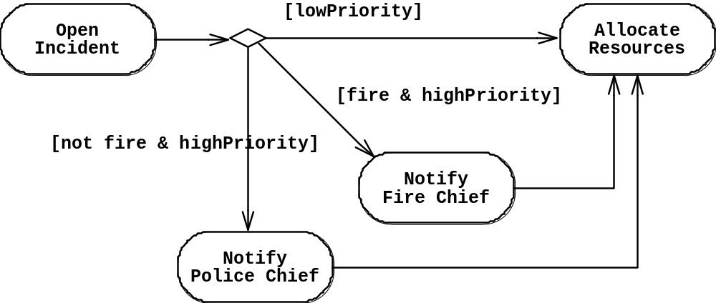
Activity Diagram: Modeling Decisions

Slide 56
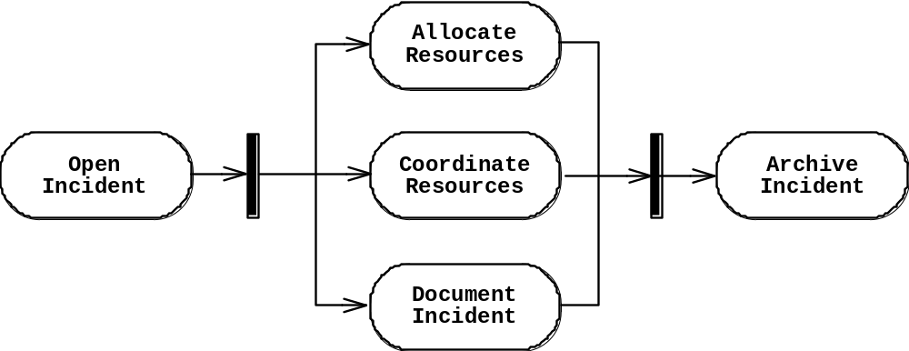
Activity Diagrams: Modeling Concurrency
Synchronization of multiple activities
Splitting the flow of control into multiple threads
Splitting
Synchronization

Slide 57
Activity Diagrams: Swimlanes
Actions may be grouped into swimlanes to denote the object or subsystem that implements the actions.
Allocate
Dispatcher
Resources
Open
Coordinate
Archive
Incident
Resources
Incident
FieldOfficer
Document
Incident

Slide 58
What should be done first? Coding or Modeling?
It all depends….
Forward Engineering:
  Creation of code from a model
  Greenfield projects
Reverse Engineering:
  Creation of a model from code
  Interface or reengineering projects
Roundtrip Engineering:
  Move constantly between forward and reverse engineering
  Useful when requirements, technology and schedule are changing frequently

Slide 59
UML Summary
UML provides a wide variety of notations for representing many aspects of software development
  Powerful, but complex language
  Can be misused to generate unreadable models
  Can be misunderstood when using too many exotic features
For now we concentrate on a few notations:
  Functional model: Use case diagram
  Object model: class diagram
  Dynamic model: sequence diagrams, statechart and activity diagrams

Slide 60
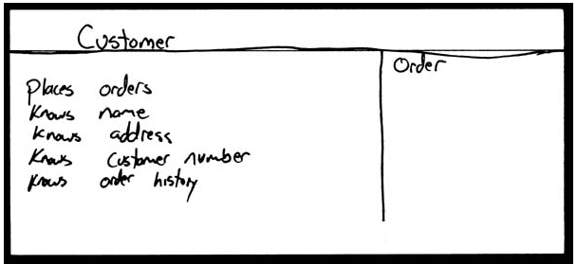
How do we design classes?
class identification from project spec / requirements
  nouns are potential classes, objects, fields
  verbs are potential methods or responsibilities of a class
CRC card exercises
  write down classes' names on index cards
  next to each class, list the following:
    responsibilities: problems to be solved; short verb phrases
    collaborators: other classes that are sent messages by this class (asymmetric)
UML diagrams
  class diagrams (today)
  sequence diagrams
  ...

Slide 61
Introduction to UML
UML: pictures of an OO system
  programming languages are not abstract enough for OO design
  UML is an open standard; lots of companies use it
What is legal UML?
  a descriptive language: rigid formal syntax (like programming)
  a prescriptive language: shaped by usage and convention
  it's okay to omit things from UML diagrams if they aren't needed by team/supervisor/instructor

Slide 62
Uses for UML
as a sketch: to communicate aspects of system
  forward design: doing UML before coding
  backward design: doing UML after coding as documentation
  often done on whiteboard or paper
  used to get rough selective ideas
as a blueprint: a complete design to be implemented
  sometimes done with CASE (Computer-Aided Software Engineering) tools
as a programming language: with the right tools, code can be auto-generated and executed from UML
  only good if this is faster than coding in a "real" language

Slide 63
UML class diagrams
What is a UML class diagram?
What are some things that are not represented in a UML class diagram?
  UML class diagram: a picture of the classes in an OO system, their fields and methods, and connections between the classes that interact or inherit from each other
  details of how the classes interact with each other
  algorithmic details; how a particular behavior is implemented

Slide 64
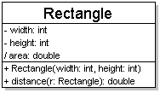
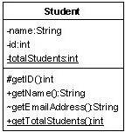
Diagram of one class
class name in top of box
  write <<interface>> on top of interfaces' names
  use italics for an abstract class name
attributes (optional)
  should include all fields of the object
operations / methods (optional)
  may omit trivial (get/set) methods
    but don't omit any methods from an interface!
  should not include inherited methods

Slide 65
Class attributes
attributes (fields, instance variables)
  visibility name : type [count] = default_value
  visibility: + public
  # protected
  - private
  ~ package (default)
  / derived
  underline static attributes
  derived attribute: not stored, but can
  be computed from other attribute values
  attribute example:
  - balance : double = 0.00

Slide 66
Class operations / methods
operations / methods
  visibility name (parameters) : return_type
  visibility: + public
  # protected
  - private
  ~ package (default)
  underline static methods
  parameter types listed as (name: type)
  omit return_type on constructors and
  when return type is void
  method example:
  + distance(p1: Point, p2: Point): double

Slide 67
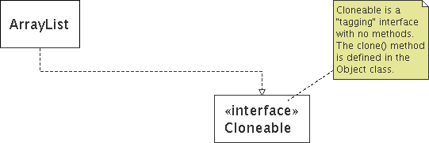
Comments
represented as a folded note, attached to the appropriate class/method/etc by a dashed line

Slide 68
Relationships btwn. classes
generalization: an inheritance relationship
  inheritance between classes
  interface implementation
association: a usage relationship
  dependency
  aggregation
  composition

Slide 69
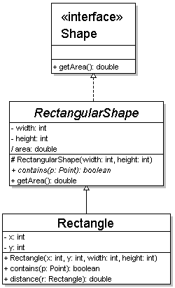
Generalization relationships
generalization (inheritance) relationships
  hierarchies drawn top-down with arrows pointing upward to parent
  line/arrow styles differ, based on whether parent is a(n):
    class:
    solid line, black arrow
    abstract class:
    solid line, white arrow
    interface:
    dashed line, white arrow
  we often don't draw trivial / obvious generalization relationships, such as drawing the Object class as a parent

Slide 70
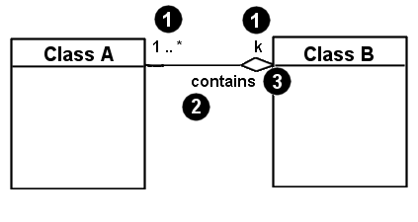
Associational relationships
associational (usage) relationships
  1. multiplicity (how many are used)
    * ⇒ 0, 1, or more
    1 ⇒ 1 exactly
    2..4 ⇒ between 2 and 4, inclusive
    3..* ⇒ 3 or more
  2. name (what relationship the objects have)
  3. navigability (direction)

Slide 71
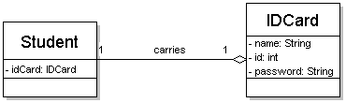
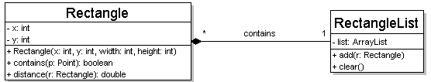
Multiplicity of associations
one-to-one
  each student must carry exactly one ID card
one-to-many
  one rectangle list can contain many rectangles

Slide 72
Association types
Car
1
1
aggregation
aggregation: "is part of"
  symbolized by a clear white diamond
composition: "is entirely made of"
  stronger version of aggregation
  the parts live and die with the whole
  symbolized by a black diamond
dependency: "uses temporarily"
  symbolized by dotted line
  often is an implementation
  detail, not an intrinsic part of
  that object's state
Engine
Book
composition
1
*
Page
dependency
Lottery
Ticket
Random

Slide 73
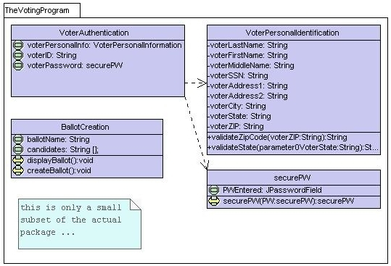
Class diagram example 1

Slide 74
Class diagram example 2
Multiplicity
Customer
1
Simple
Aggregation
Class
Abstract
Class
Rental Invoice
Rental Item
1..*
1
0..1
Composition
Simple
Association
Generalization
Checkout Screen
DVD Movie
VHS Movie
Video Game

Slide 75
Class diagram example 3
StudentBody
Student
1
100
- firstName : String
- lastName : String
- homeAddress : Address
- schoolAddress : Address
+ main (args : String[])
+ toString() : String
Address
- streetAddress : String
- city : String
- state : String
- zipCode : long
+ toString() : String

Slide 76
Tools for creating UML diags.
Violet (free)
  http://horstmann.com/violet/
Rational Rose
  http://www.rational.com/
Visual Paradigm UML Suite (trial)
  http://www.visual-paradigm.com/
  (nearly) direct download link:
  http://www.visual-paradigm.com/vp/download.jsp?product=vpuml&edition=ce
(there are many others, but most are commercial)

Slide 77
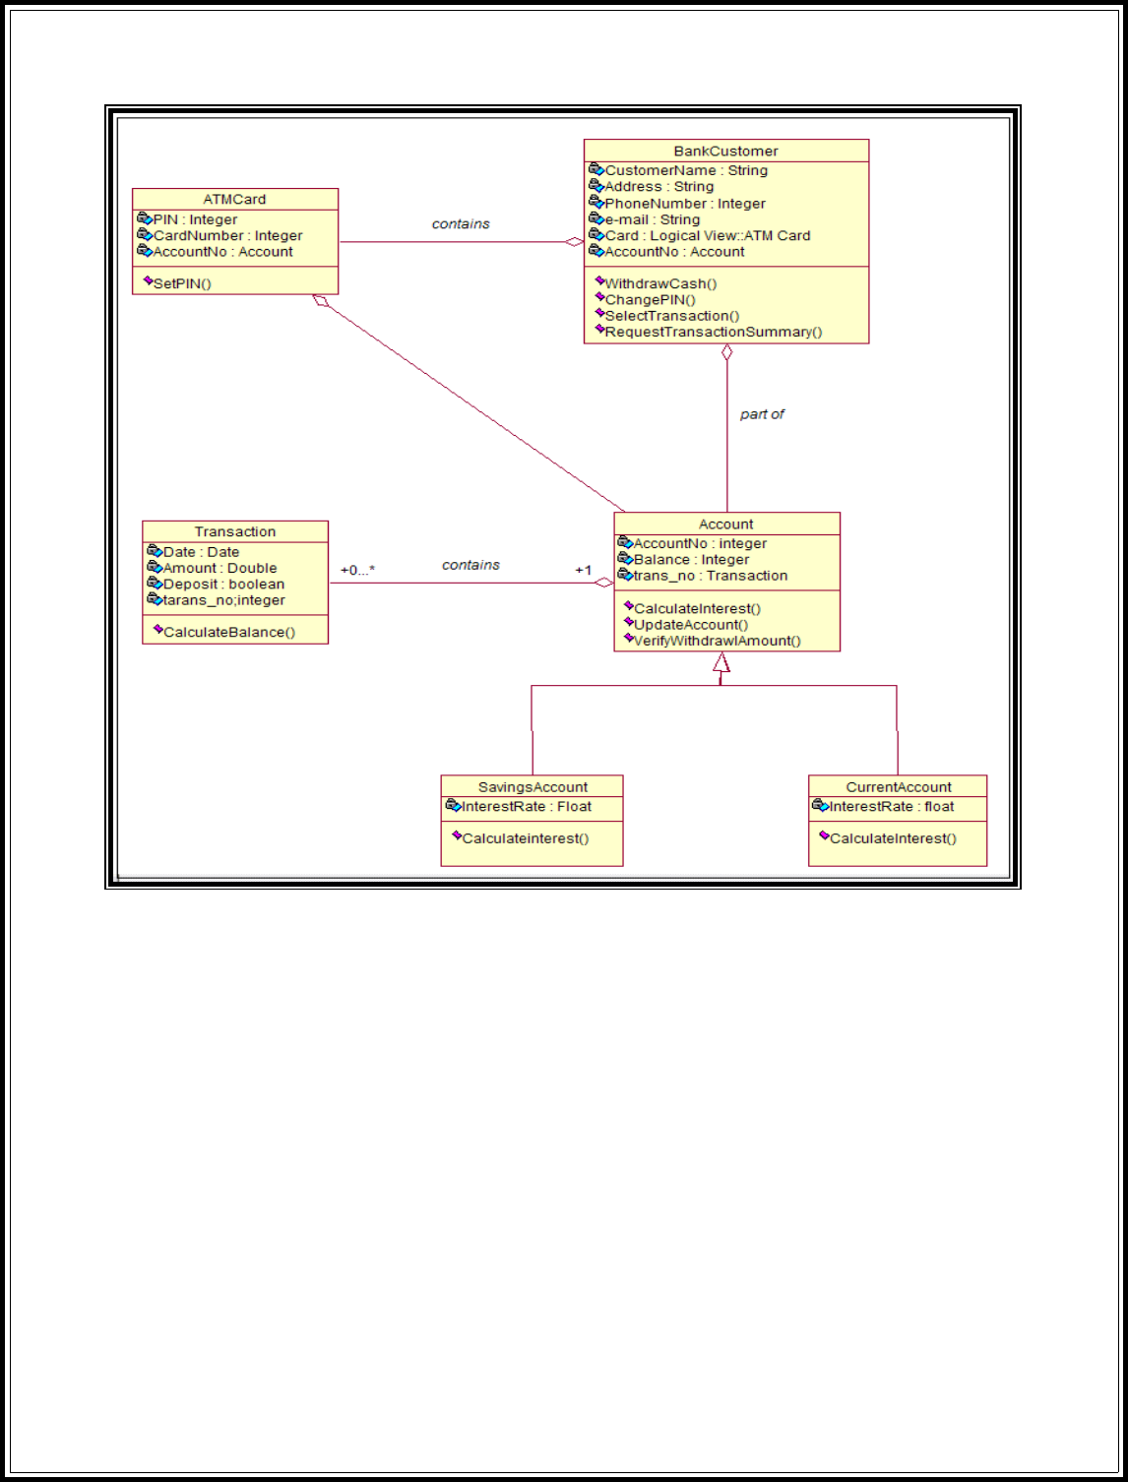

Slide 78
Class design exercise
Consider this Texas Hold 'em poker game system:
  2 to 8 human or computer players
  Each player has a name and stack of chips
  Computer players have a difficulty setting: easy, medium, hard
  Summary of each hand:
    Dealer collects ante from appropriate players, shuffles the deck, and deals each player a hand of 2 cards from the deck.
    A betting round occurs, followed by dealing 3 shared cards from the deck.
    As shared cards are dealt, more betting rounds occur, where each player can fold, check, or raise.
    At the end of a round, if more than one player is remaining, players' hands are compared, and the best hand wins the pot of all chips bet so far.
  What classes are in this system? What are their responsibilities? Which classes collaborate?
  Draw a class diagram for this system. Include relationships between classes (generalization and associational).

Slide 79
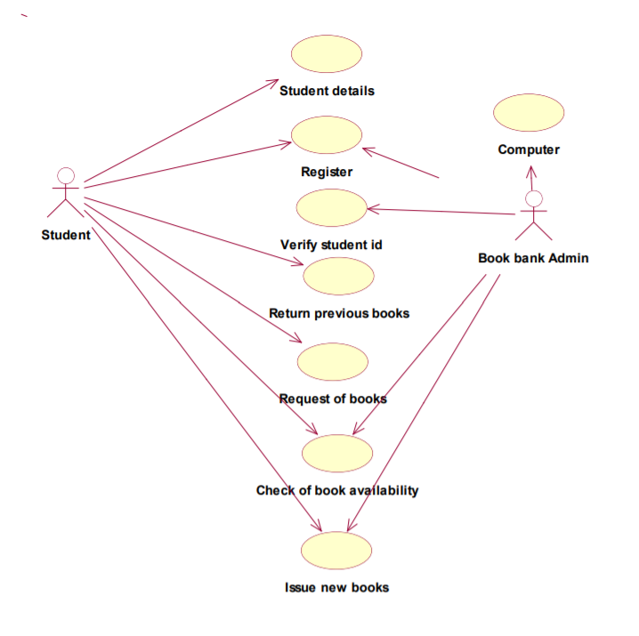

Slide 80
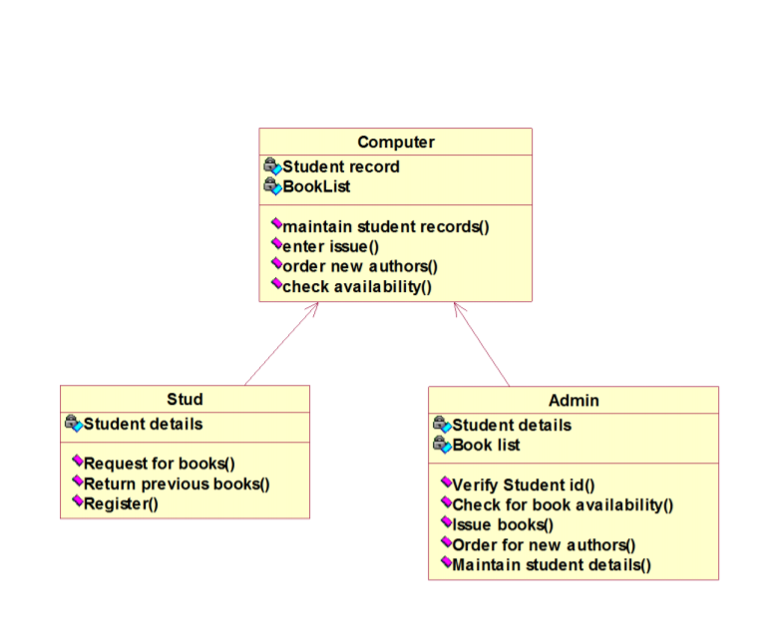

Slide 81
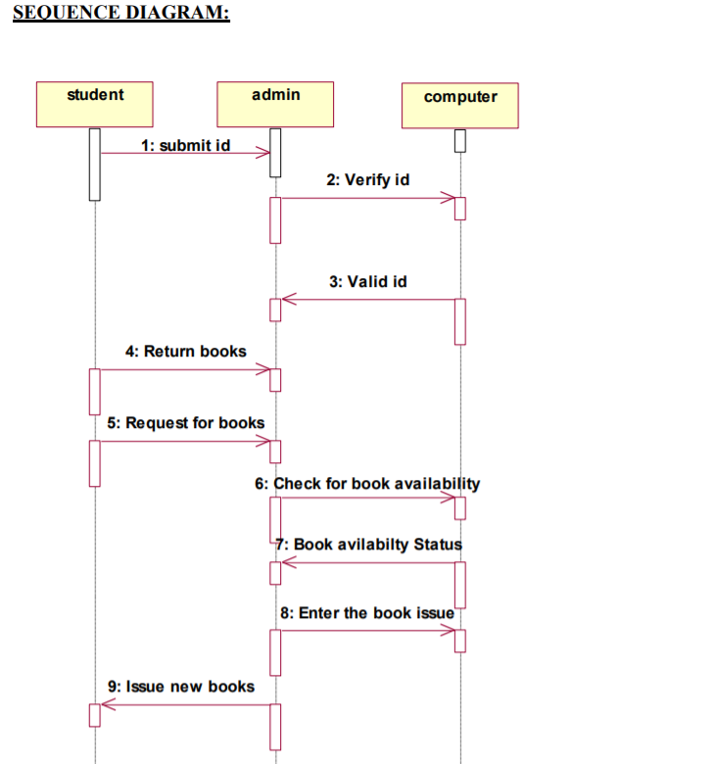

Slide 82
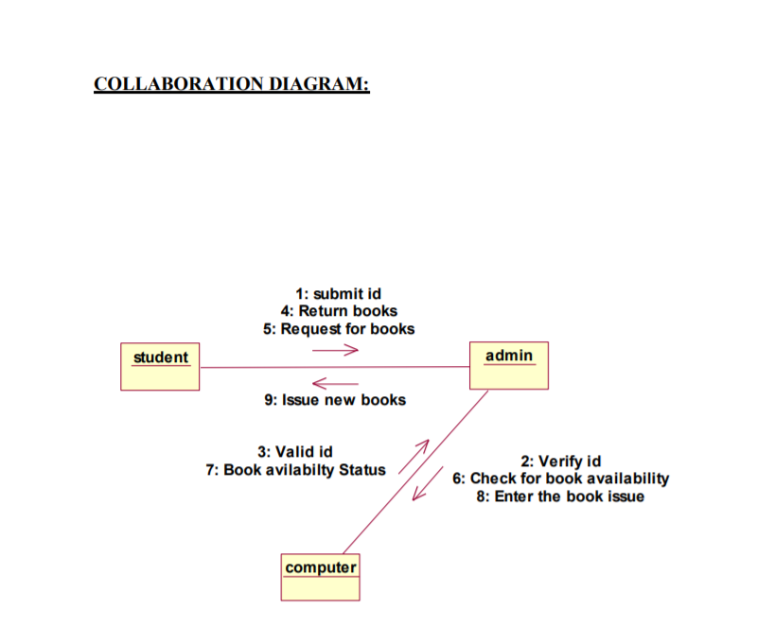

Slide 83
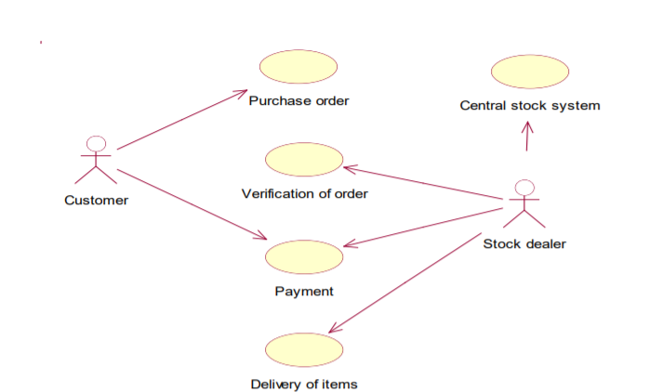

Slide 84
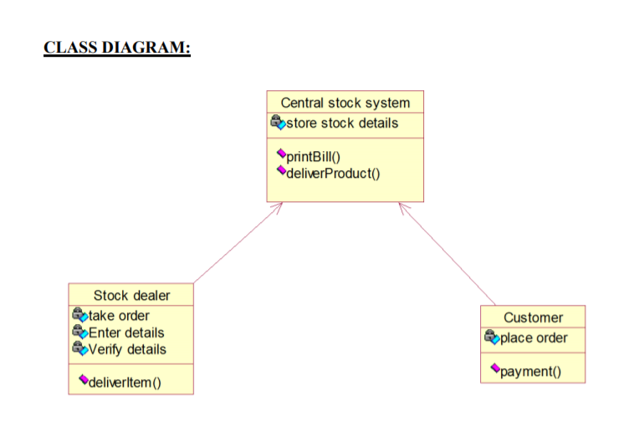

Slide 85
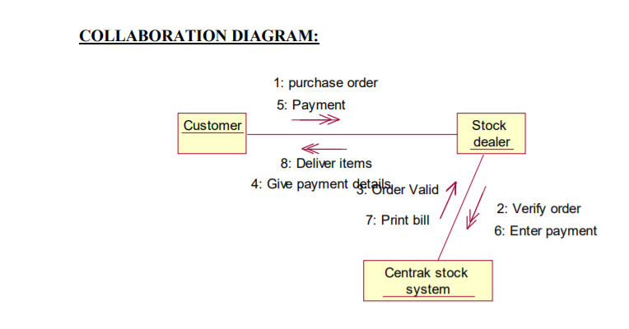

Slide 86
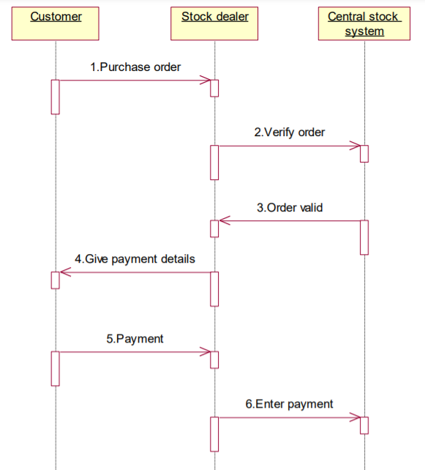

Slide 87
